Slide 1
Business Analytics
Analyze NYSE Data – Project 2

Slide 2
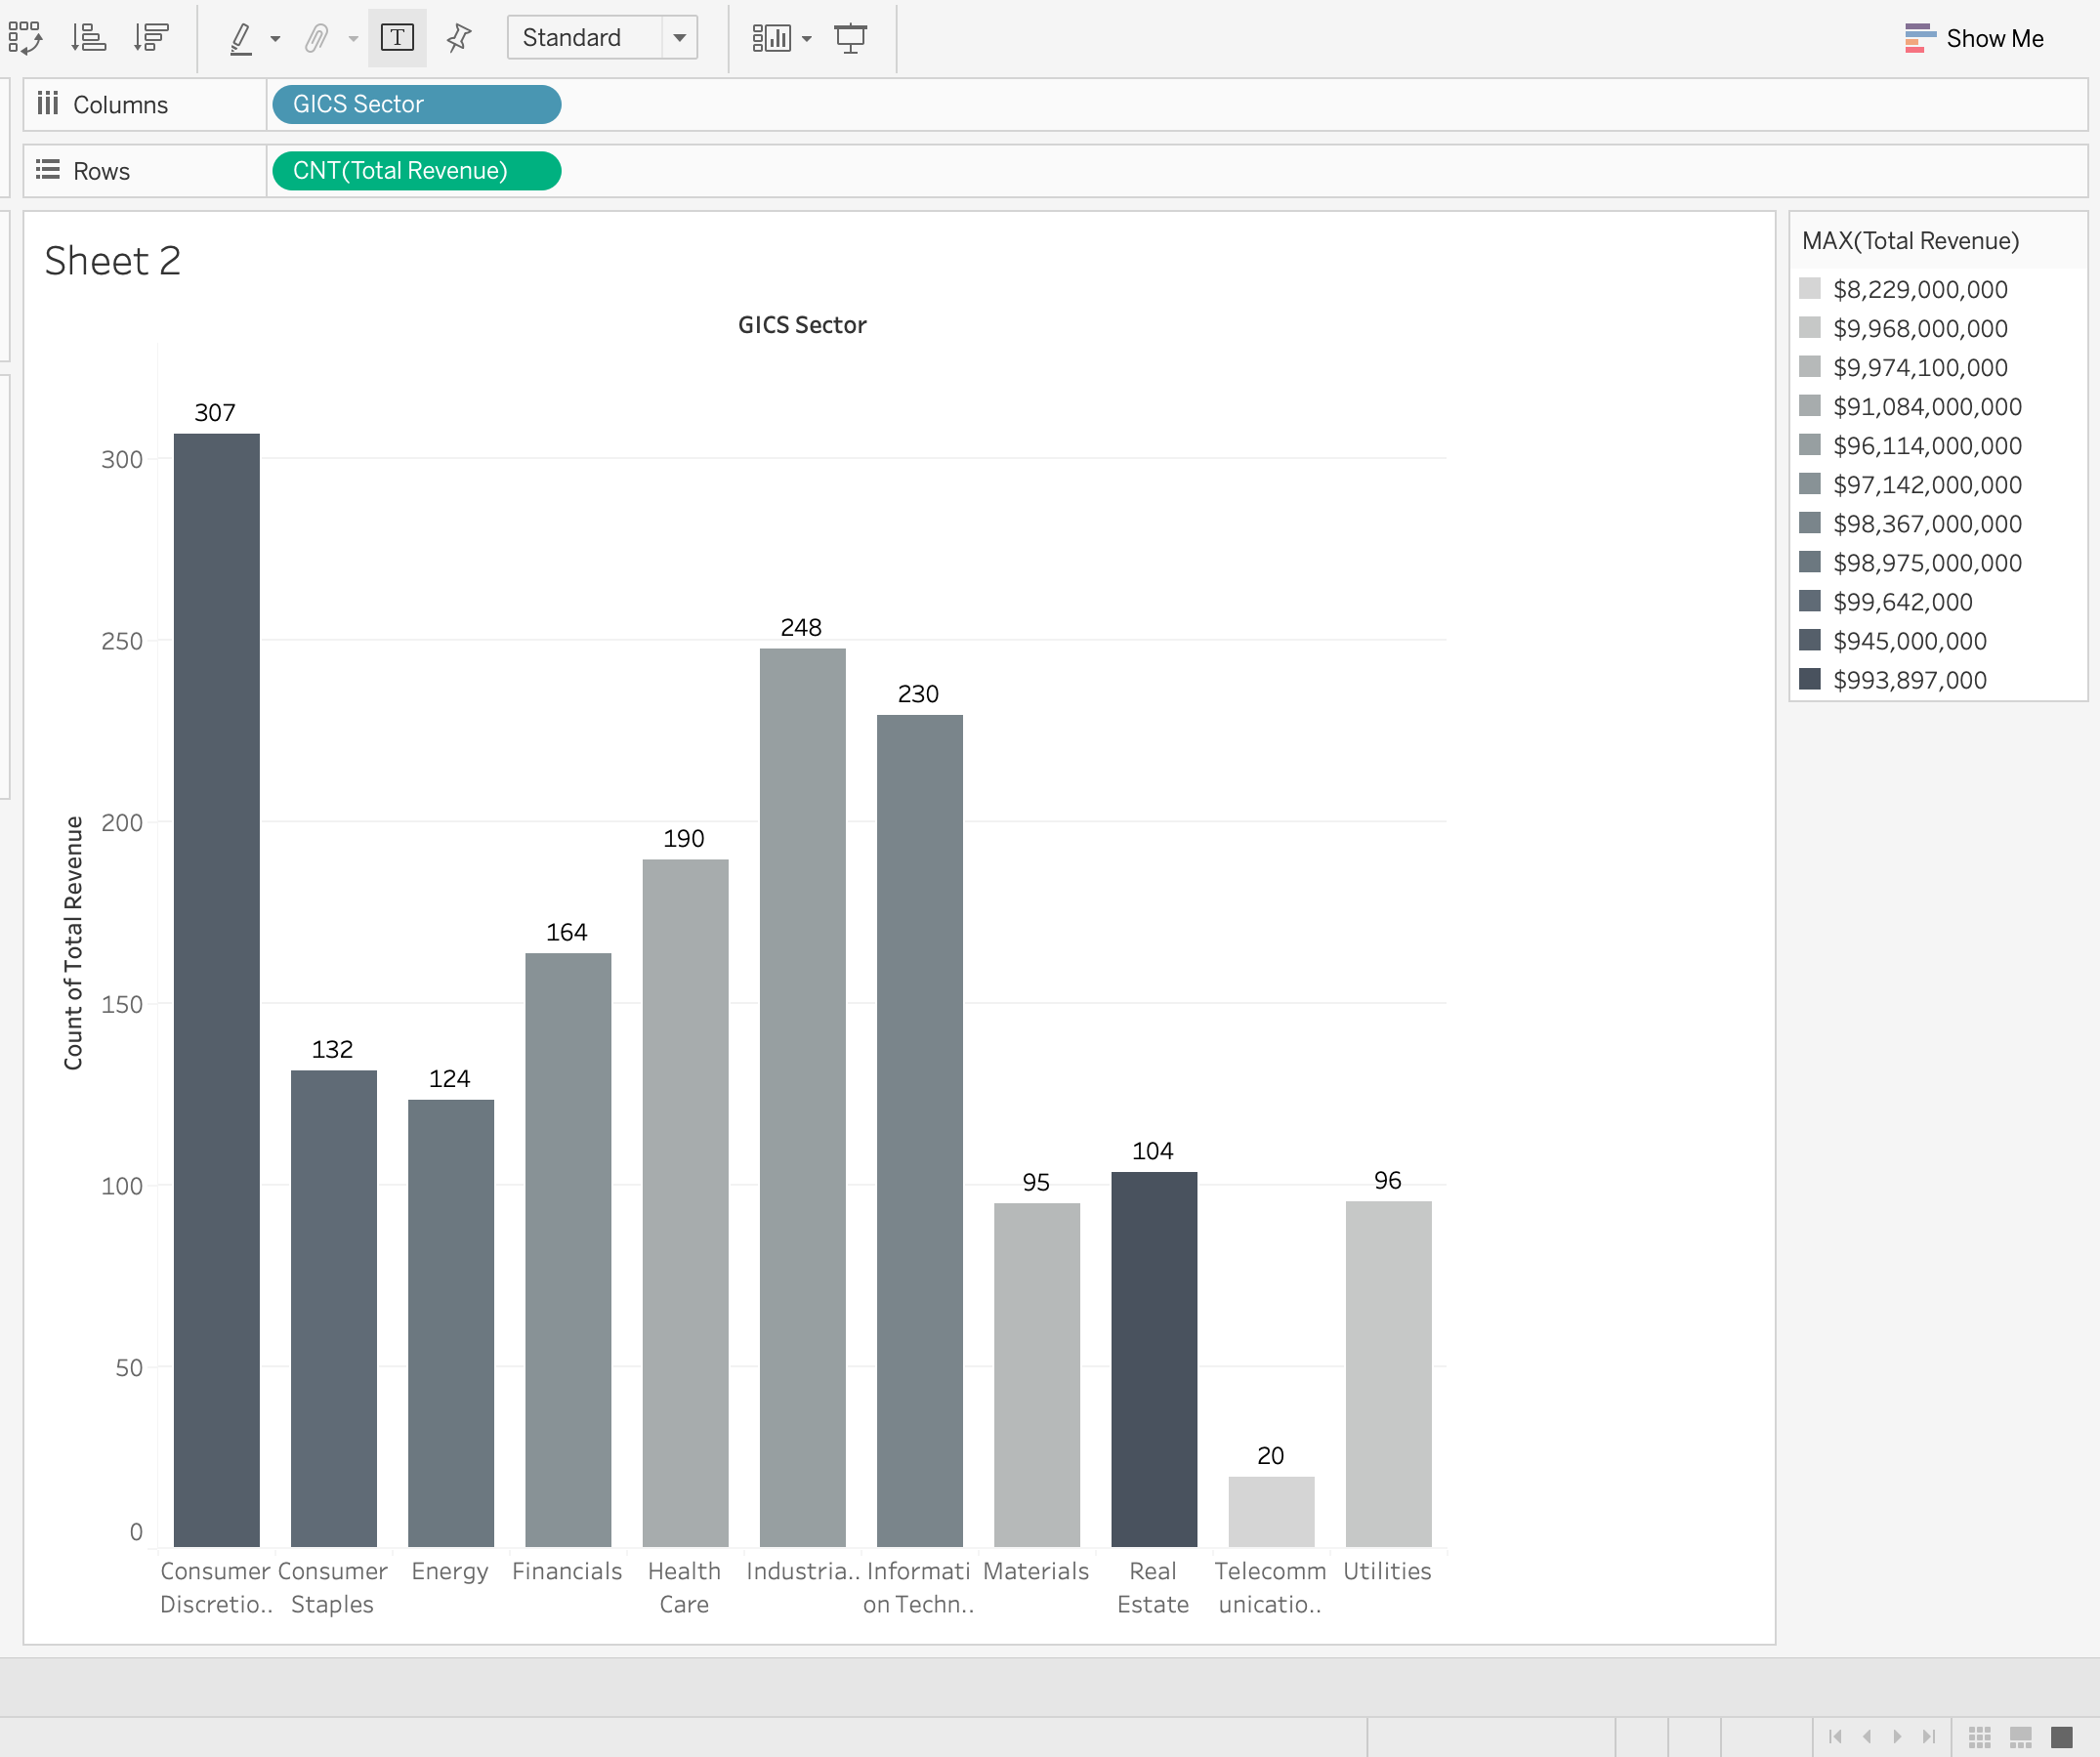
Q\ What are the three sectors that have highest revenue
This chart represents the top three sectors that have the highest revenue which are Consumer discretionary , industrials and information technology sector.

Slide 3
Q\ What are the three sectors that have highest revenue
After I calculate the total revenue average for Apparel, Accessories & Luxury Goods for and Broadcasting & Cable TV which are companies categorized under Consumer Discretionary in 2012,2013,2014 and 2015. I found out that Broadcasting & Cable TV has the heights mean with $22,917,075,667.
On the other hand, The Median total revenue for companies categorized under Consumer Discretionary which are Apparel, Accessories & Luxury Goods $7,966,674,000 that has higher median total revenue compared to the median for Broadcasting & Cable TV $7,752,728,000.
 | Apparel, Accessories & Luxury Goods | Broadcasting & Cable TV
Standard deviation | 89256.2266 | 88049.57694
Range | 190,408,112,000 | 190,474,604,000
As you see in the table that shows the standard deviation and the range for both categoriztions we can that the numbers are pretty similar for their range. For the standard deviation the Apparel, Accessories & Luxury Goods is higher compared to Broadcasting & Cable TV

